Slide 1

Minions
Whiskey Recommendation System

Slide 2

Contents
01
02
03
04
About Team
About Project
Data Description
Methods and Result

Slide 3




About Team
Minions Dojo
Leader
TaeSeung Lee
Dokyeong Kwon
Seungwoo Park

Slide 4
2. About Project

Slide 5

About Project
“Whiskey Recommendation System”
Analyze the whiskey survey and recommend another Whiskey that the user would like by receiving one of the favorite whiskey.

Slide 6
3. Data Description

Slide 7
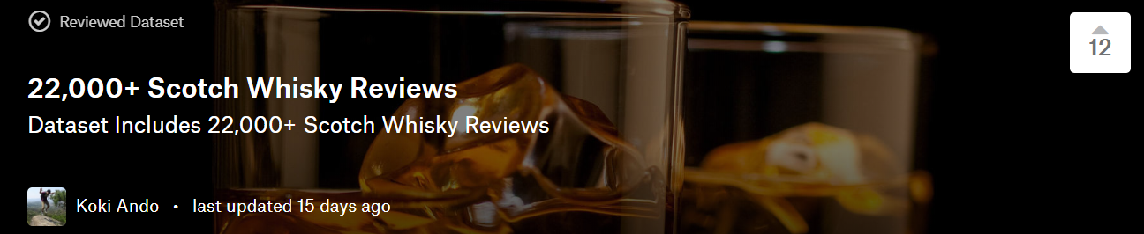
Data Description
Site : https://www.kaggle.com/koki25ando/22000-scotch-whisky-reviews
22,000+ Scotch Whisky Reviews

Slide 8

Data Description
Column Name | About
Index | Index Numbering
Name | Name of whiskey bottle
Category | Whisky Category
Review Point | Point marked by each reviewers
Price | Price of each bottle
Currency | Unit of price
Description | Descriptions of reviews

Slide 9
4. Methods and Results

Slide 10



Methods
Language
Libraries
Tool
Python
Jupyter Notebook
numpy
pandas
matplotlib

Slide 11
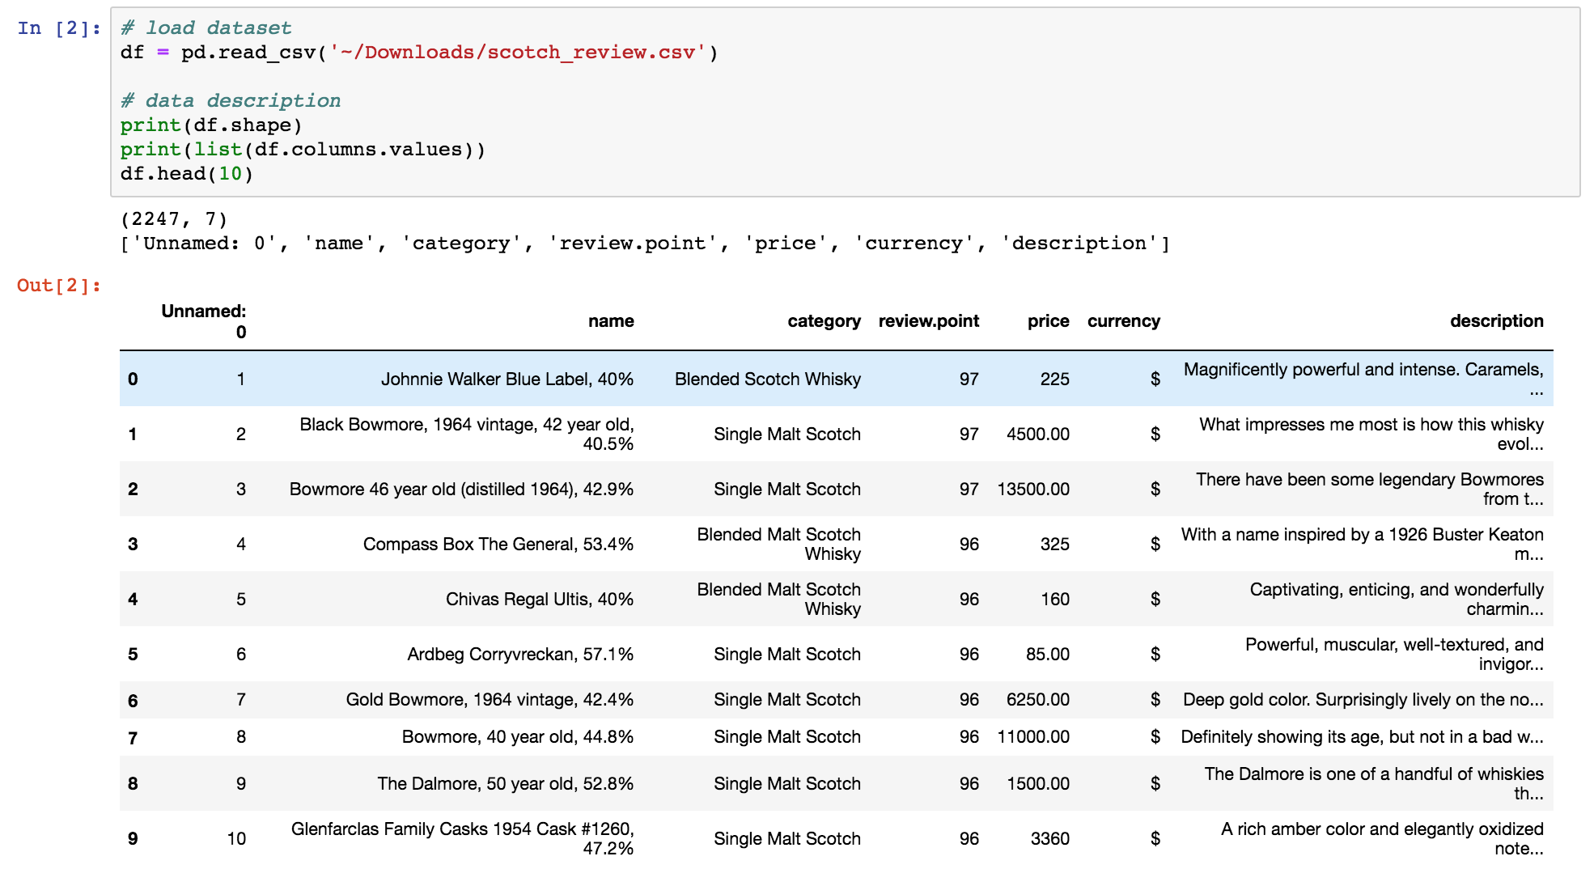
Results
Shape, column names and top 10 values of Dataset ‘scotch_review.csv’

Slide 12
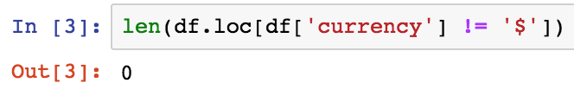
Results
Only dollars in the currency column

Slide 13
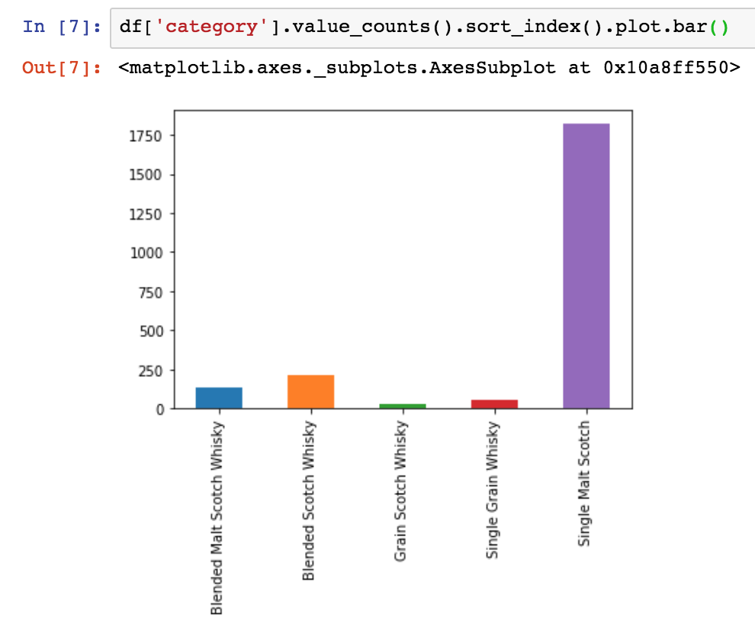
Results
Category plot

Slide 14
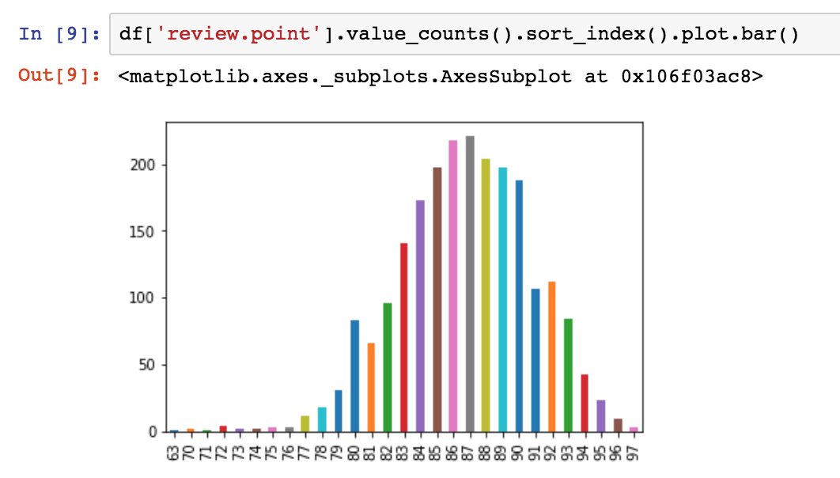
Results
Review point plot

Slide 15
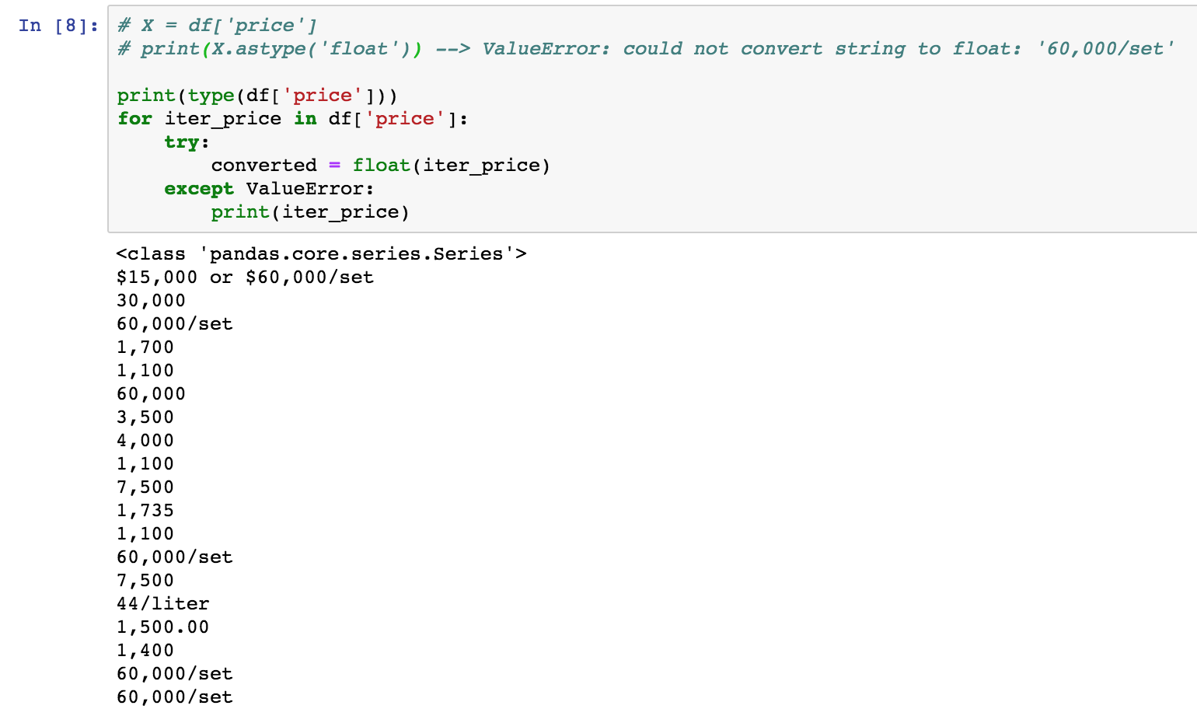
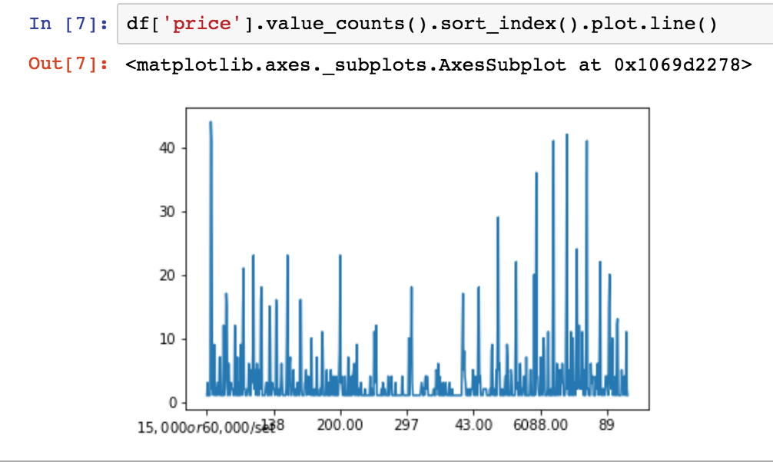
Results
Price plot

Slide 16

Next week
Due to we need the analysis about whiskey description, we will decide the method for text analysis.

